Slide 1

DEPARTMENT OF COMPUTER ENGINEERING, MODELING, ELECTRONICS AND SYSTEM ENGINEERING LM-Telecommunication Engineering: Smart Sensing, Computing and Networking IoT device programming
Project Title : Air Quality Monitoring System in Smart Parking
Implemented by :
Rami Saleh , matricula : 251588
Hussein Mohammad , matricula : 247528

Slide 2
Introduction
As urban areas continue to grow, parking management and air quality have become significant concerns.
Challenge: Traditional parking systems often lack automation and real-time environmental monitoring, leading to inefficient parking management and poor air quality control.
Solution: To address these challenges, we have developed an innovative Air Quality Parking System that integrates smart parking management with air quality monitoring and control.

Slide 3
Introduction
Project Overview:
Objective: The primary goal of this project is to enhance parking efficiency and ensure a healthier environment in parking facilities by automating car entry/exit control and monitoring air quality.
Components used:
ESP32
PIR sensors
servo motor
fan 12 V
MQ-2 gas sensor
LED

Slide 4
Components and Connections
ESP32 Microcontroller : Central control unit.
PIR Sensors : Detect car movement (Motion) at entry and exit.
Servo Motor (Door) : Opens and closes the parking gate.
Fan 12 V : Provides ventilation.
MQ-2 Gas Sensor : Monitors levels of Carbon monoxide (CO) and smoke.
Light (LED) : Turn on when the Door opens and turn off when the Door closes.
Android Application: Interface for remote monitoring and control.

Slide 5
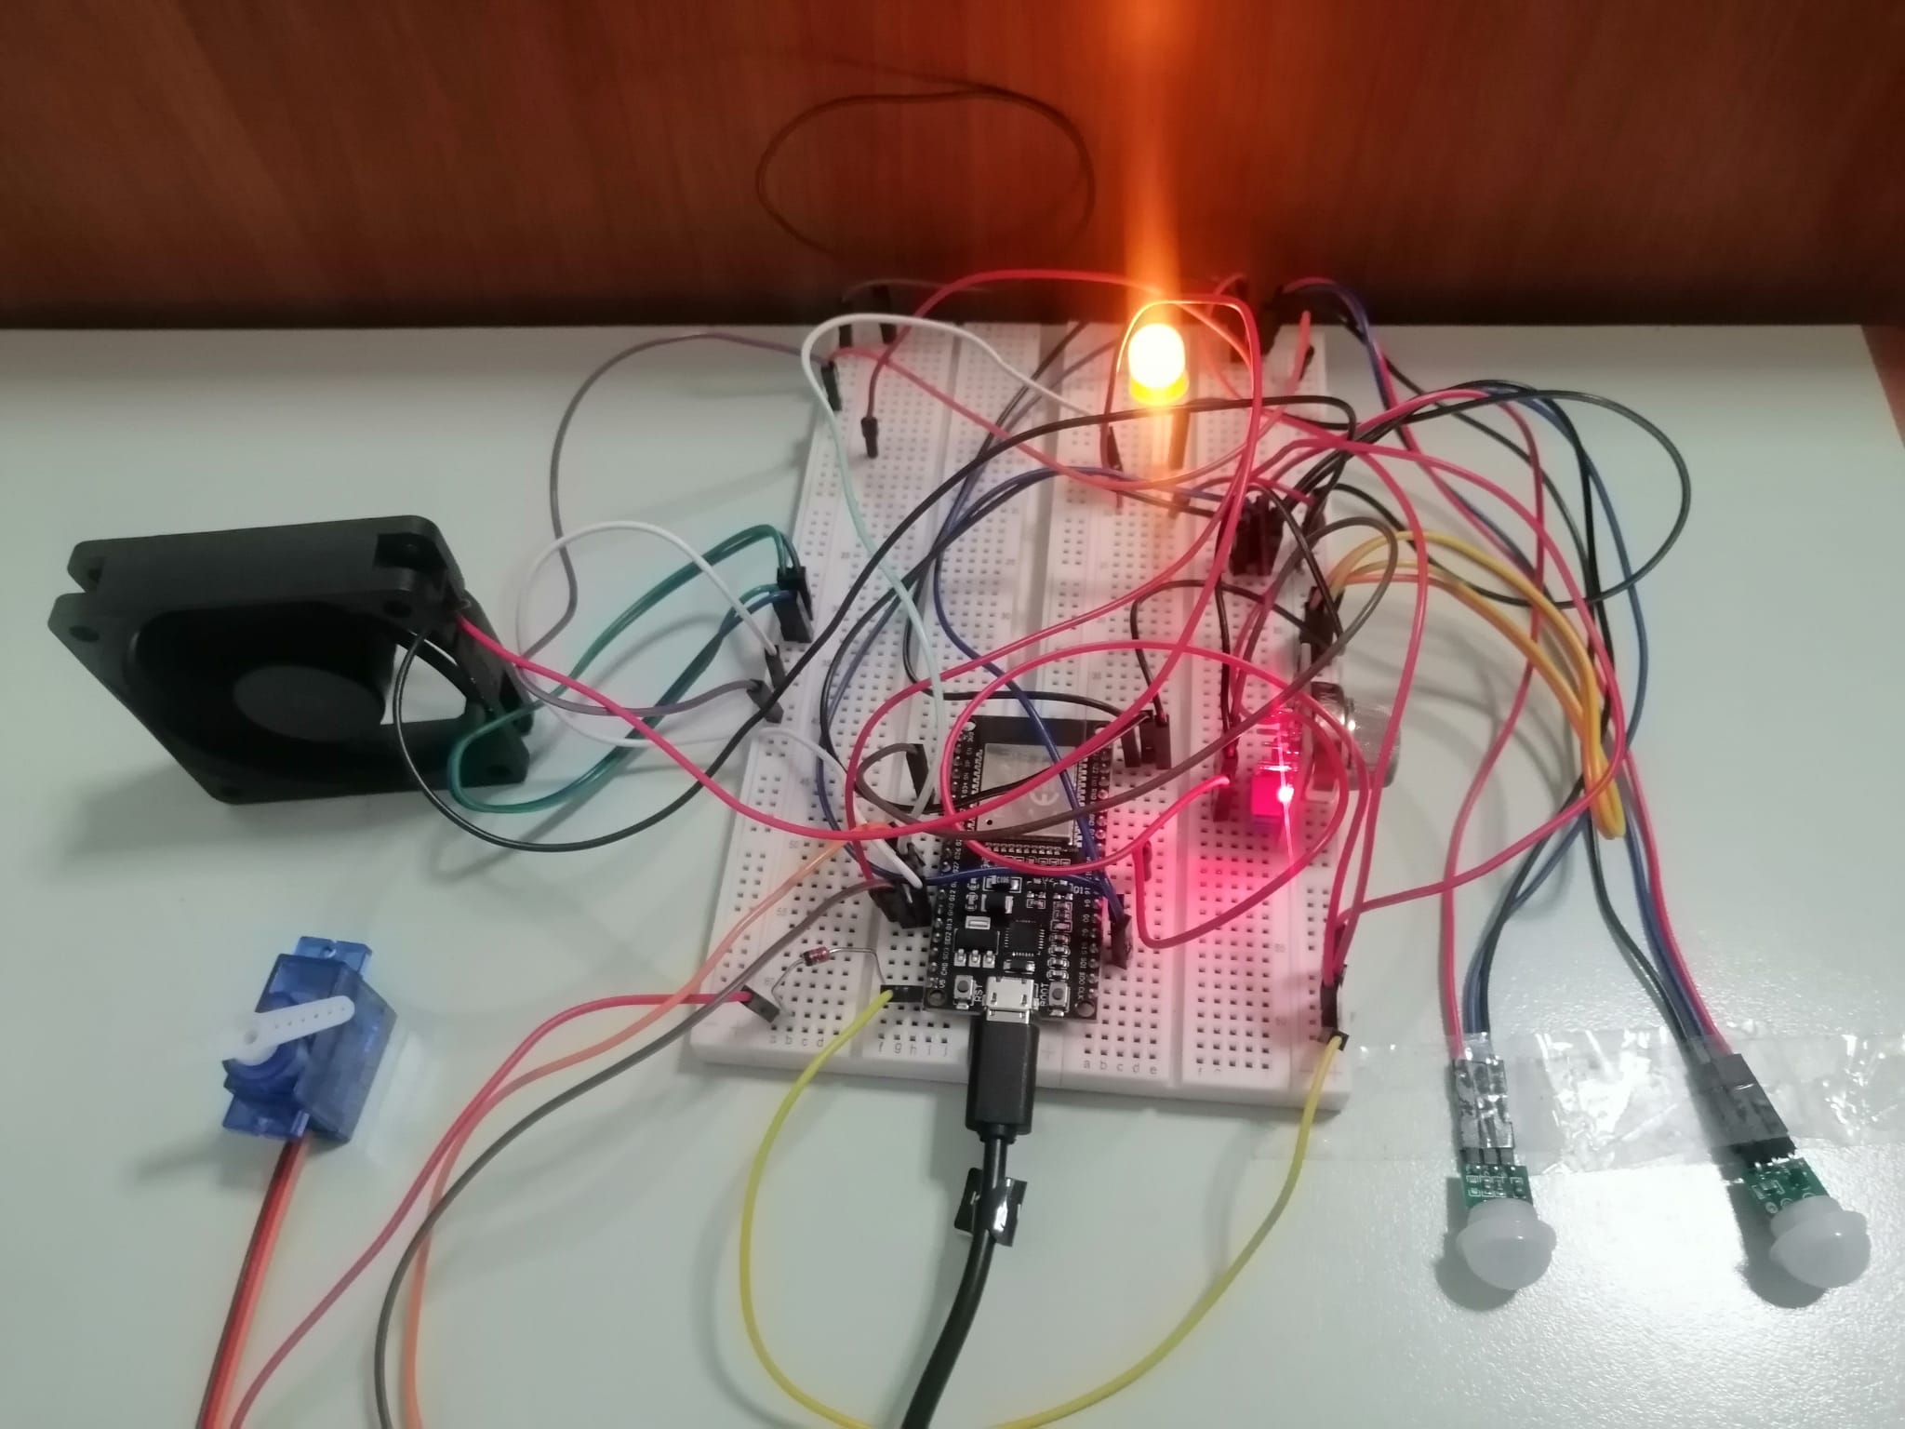
Circuit Diagram

Slide 6
The operation
The PIR sensors detect the movement of the car and accordingly, opens the gate and when the gate opens ,the LED lights up and after that when the gate closes the LED light will turn off.
and the MQ2 gas sensor detects CO and smoke gases and then calculates their concentration and accordingly, the fan turn on and pull air out to reduce the proportion of gases inside the parking system.
When the proportion of CO gas value is 35 (threshold) or more the fan works or when the smoke gas reaches to the value equal to 12 (threshold) or more the fan also works , and we use a button to control the fan manually to turn it off and on.

Slide 7
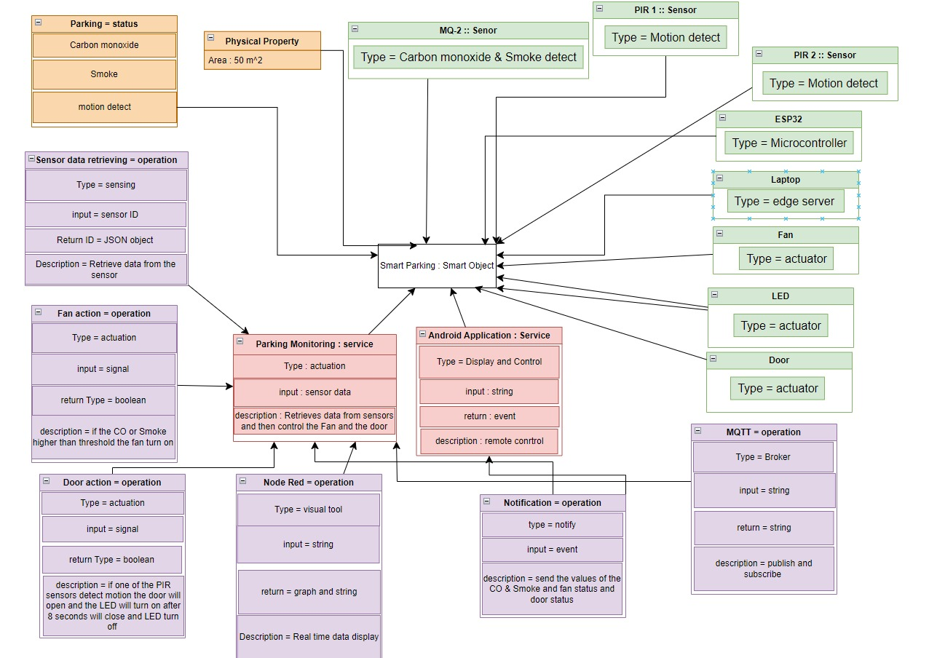
Project Met model

Slide 8
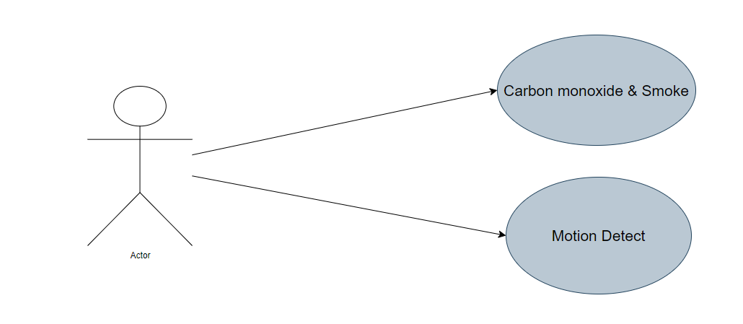
Use Case

Slide 9
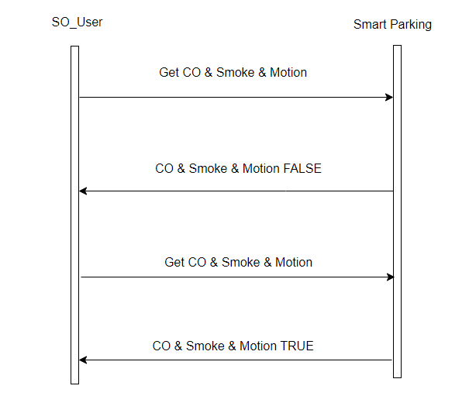
Sequence Diagram

Slide 10
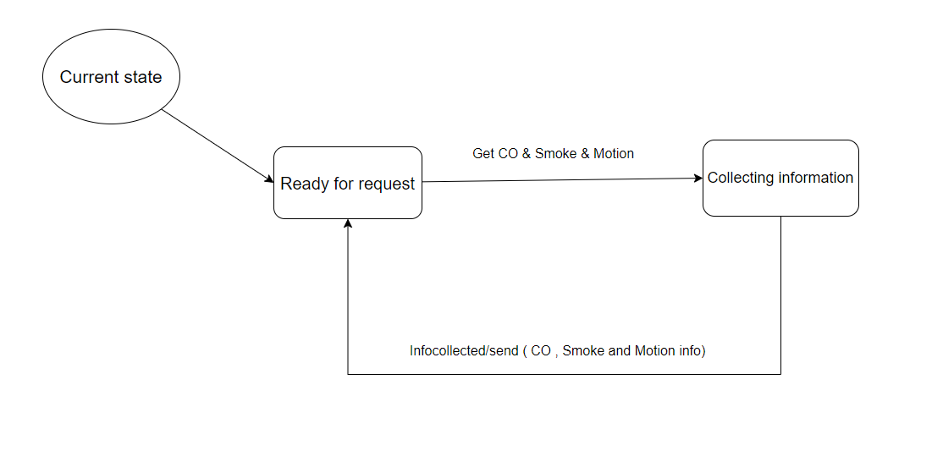
State Machine

Slide 11
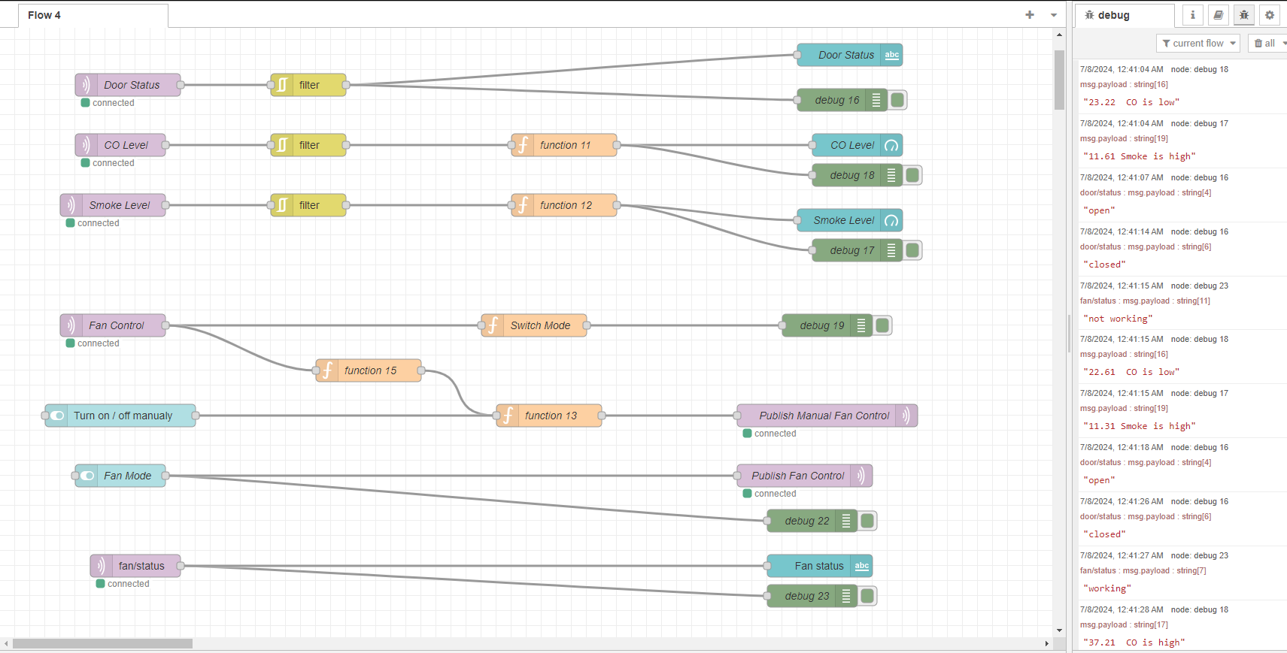
Node Red

Slide 12
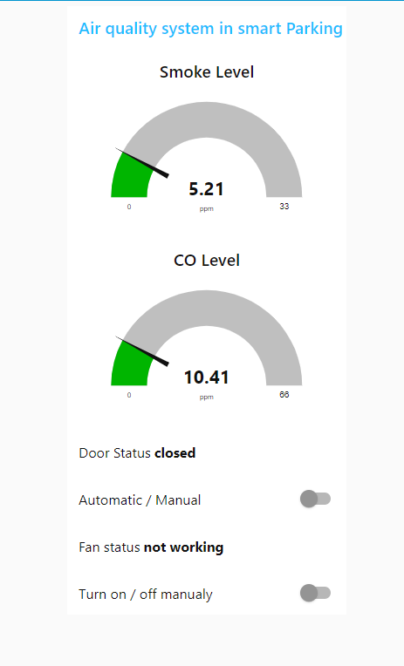
Node Red – Dashboard

Slide 13
Node Red
In the Project there is 6 Topics
There are 4 subscribe Topics which receive messages that send by ESP32 through MQTT Broker.
Door Status Block: is MQTT-in block for topic (door/status) which receive a string (the door status ‘open’ or ‘ closed’).
CO Level Block: is MQTT-in block for topic (co/level) which receive a value of Carbon Monoxide and then there is a ‘ Function’ block which compare the value with threshold like ESP32 and then determine (if the CO is High or low) and then print it in ‘Debug’ block.
Smoke Level Block: is MQTT-in block for topic (smoke/level) which receive a value of Smoke and then there is a ‘ Function’ block which compare the value with threshold like ESP32 and then determine (if the Smoke is High or low) and then print it in ‘Debug’ block.

Slide 14
Node Red
Fan/Status Block: is MQTT-in block for topic (fan/status) which receive a string (the Fan status ‘working’ or ‘ not working’).
There are Two publish topics and we can publish data to the ESP32 from the Node Red and from android application too.
Publish Fan Control: is MQTT-out block for topic (control/fan) which send the desired mode for the fan if it's automatic mode or manual mode
It will send ‘1’ (which comes from the ‘switch’ block) to specify automatic mode.
It will send ‘0’ (which comes from the ‘switch’ block) to specify Manual mode.
Publish Manual Fan Control: is MQTT-out block for topic (control/fan/manual) which control the fan manually
It will send ‘1’ (which comes from the ‘switch’ block) to Turn on The Fan.
It will send ‘0’ (which comes from the ‘switch’ block) to Turn off The Fan.

Slide 15
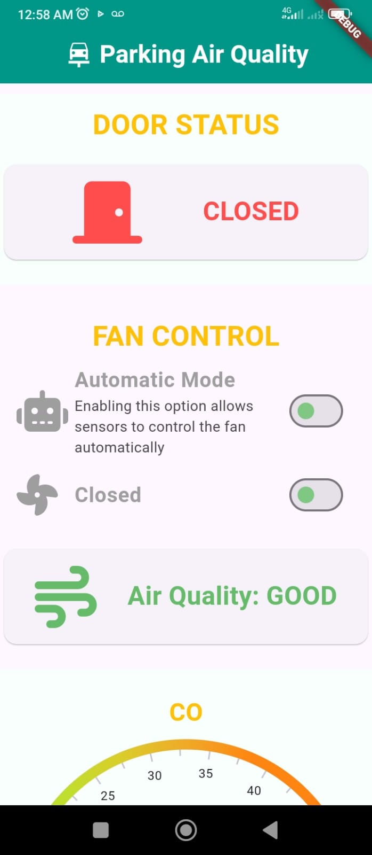
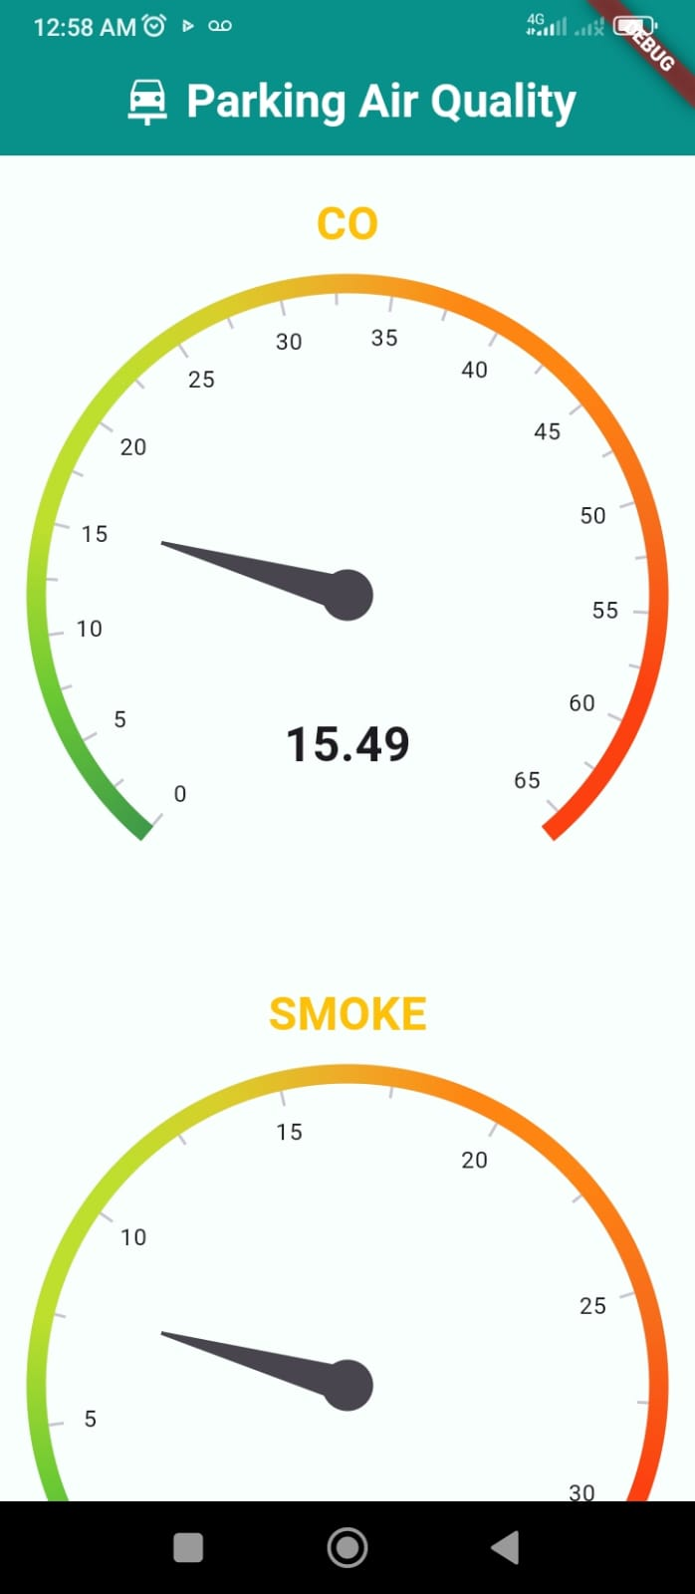
Results: Application interface

Slide 16
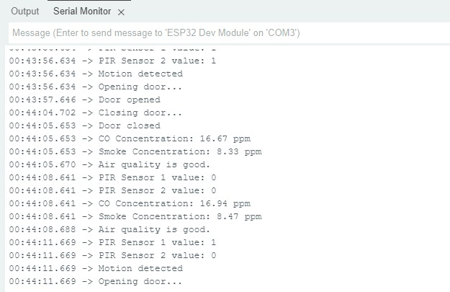
Results: Serial Monitor

Slide 17

Conclusion
Summary: Smart parking system integrating car detection, gate control, air quality management,
and remote monitoring.
Future Improvements:
Enhance mobile app features.
Implement advanced analytics for air quality data.
Explore integration with other smart city solutions

